Slide 1
Architectural Optimization of
Decomposition Algorithms for Wireless Communication Systems
Ali Irturk†, Bridget Benson†, Nikolay Laptev‡, Ryan Kastner†
† Department of Computer Science and Engineering University of California, San Diego {airturk, b1benson, kastner}@cs.ucsd.edu
‡Department of Computer Science University of California, Los Angeles nlaptev@cs.ucla.edu
April 2009

Slide 2
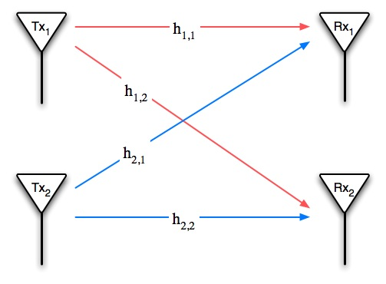
Motivation
QR,
A⁻¹
Matrix Decompositions are essential computations for wireless communications;
Matrix Decompositions are used for simplifying matrix inversion which are used in
  Equalization algorithms to remove the effect of the channel on the signal,
  Minimum mean square error algorithms for pre-coding in spatial multiplexing,
  Detection-estimation algorithms in space-time coding.

Slide 3

Motivation
There are a number of tools that translate Matlab algorithms to a hardware description language;
However, we believe that the majority of these tools take the wrong approach;
We take a more focused approach, specifically developing a tool that is targeting matrix computation algorithms.

Slide 4
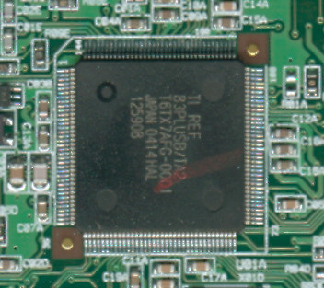
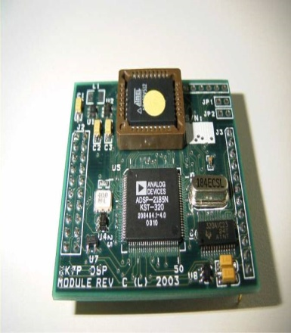
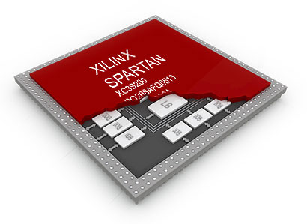
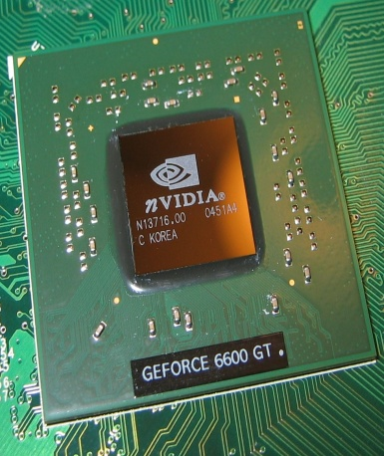
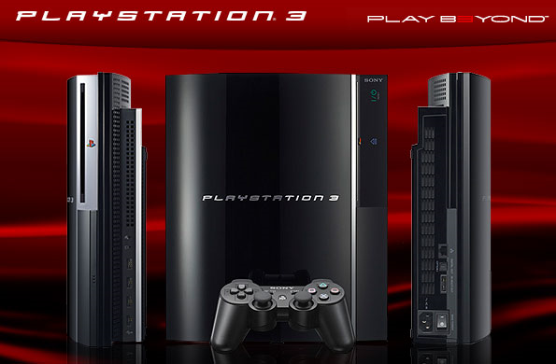
Computing Platforms
ASICs
DSPs
FPGAs
GPU
CELL BE
Exceptional Performance
Long Time to Market
Substantial Costs
Ease of Development
Fast Time to Market
Low Performance
Ease of Development
Fast Time to Market
ASIC-like Performance

Slide 5
Major Contributions
Design of a novel tool, GUSTO, for automatic generation and optimization of application specific matrix computation architectures from a given Matlab algorithm;
Comparison of different matrix decomposition methods in terms of different matrix dimensions, bit widths and parallelism;
Thorough study of area and throughput tradeoffs of matrix decomposition architectures using different parameterizations;
A case study: Implementation of Adaptive Weight Calculation Core using QRD-RLS algorithm.

Slide 6
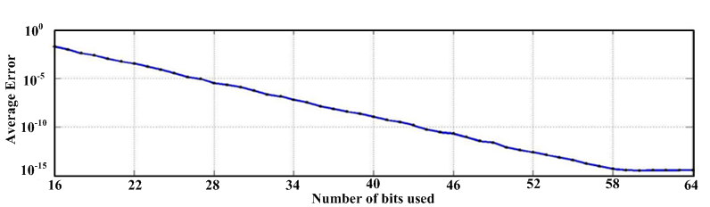
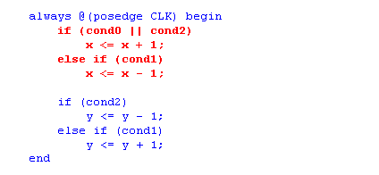
GUSTO
General architecture design Utility and Synthesis Tool for Optimization
GUSTO
an easy-to-use tool for more efficient design space exploration and development;
automatically generates and optimizes application specific architectures;
creates a prototype hardware system in just minutes instead of days or weeks.
  10⁰
  10⁻⁵
  Average Error
  10⁻¹⁰
Algorithm
(e.g. QR decomposition)
GUSTO
  10⁻¹⁵
  16
  40
  34
  40
  46
  52
  58
  64
  22
  28
  Number of bits used
  Bit width
  (e.g. 19 bits of precision)
  Error Analysis
  Resource Allocation
  (e.g. 4 multipliers and 3 adders)
  HDL files
Modes
  (e.g. Heterogeneous cores connected using hierarchical datapaths)

Slide 7
Outline
Motivation
GUSTO: Design Tool and Methodology
Decomposition Methods
Results
  Inflection Point Analysis
  Architectural Design Alternatives
Conclusions

Slide 8


GUSTO
Design Flow
Algorithm
Algorithm Analysis
Instruction Generation
Type and # of Arithmetic Resources
Resource Allocation
Design Library
Error Analysis
Error Analysis
Data Representation
Architecture Generation
General Purpose Architecture
Collecting Scheduling Information
Resource Trimming for Hardware Optimization
Application Specific Architecture
Area, Latency and Throughput Results
Simulation
Results

Slide 9
GUSTO
Design Flow
GUSTO provides options to divide the given algorithm into smaller processing elements which are small in area and highly optimized for throughput.
Software Defined Radio
Algorithm
Algorithm Analysis
PE
PE
Software Defined Radio
PE
PE
?
PE
PE
PE
PE
PE
PE
PE
PE
Inst.
Cont.
A
Mem.
Cont.
A
A
A
M
M
M
M
Processing Element

Slide 10

GUSTO
Design Flow
GUSTO uses instruction scheduling for better resource utilization and provides different scheduling methods.
Instruction Generation
GUSTO generates resource constrained architectures, i.e. the user chooses the number and type of arithmetic units.
Resource Allocation
Type and # of Arithmetic Resources
+
*
-
/
Design Library
?
Inst.
Cont.
A
Mem.
Cont.
A
A
A
M
M
M
M
Processing Element

Slide 11
GUSTO
Design Flow
GUSTO employs fixed point arithmetic in generated architectures;
GUSTO performs error analysis to find an appropriate fixed point representation which provides results with the accuracy similar to that of a floating point implementation.
Error Analysis
Error Analysis
User Defined Input Data
GUSTO
MATLAB
Fixed Point Arithmetic Results
(using variable bit width)
Floating Point Arithmetic Results
(Single/Double precision)
Error Analysis Metrics:
Mean Error
Peak Error
Standard Deviation of Error
Mean Percentage Error

Slide 12
GUSTO
Design Flow
GUSTO generates a CPU like architecture with
  Dynamic Instruction Scheduling;
  Dynamic Memory Assignments;
  Full Connectivity between functional units.
Architecture Generation
Full Connectivity
Arithmetic Unit
Instruction Controller
Arithmetic Unit
Memory Controller
Arithmetic Unit
Arithmetic Unit
Adders
Multipliers
Multipliers
Multipliers
Multipliers
Multipliers
Dynamic Instruction Scheduling
Dynamic Memory Assignments
Arithmetic Units

Slide 13
GUSTO
Design Flow
GUSTO collects scheduling information from instruction and memory controllers.
GUSTO uses this information to eliminate unneeded resources, automatically creating a small, fast statically scheduled architecture.
Collecting Scheduling Information
Arithmetic Unit
Instruction Controller
Arithmetic Unit
Memory Controller
Arithmetic Unit
Arithmetic Unit
Adders
Full Connectivity
Multipliers
Multipliers
Multipliers
Multipliers
Multipliers
Static Instruction Scheduling
Static Memory Assignments
Arithmetic Units

Slide 14
GUSTO
Design Flow
GUSTO simulates the architecture to define the usage of arithmetic units, multiplexers, register entries and input/output ports and trims away the unused components with their interconnects.
GUSTOs’ optimization provides tremendous silicon savings while ensuring the correctness of solution.
Resource Trimming for Hardware Optimization
Adder
Full Connectivity
Required Connectivity
Adder
Multiplier
Multiplier
Memory
Memory

Slide 15

GUSTO
Trimming Feature
In_A1
In_A2
In_B1
In_B2
In_mem1
A
B
mem
Out_A
Out_B
Out_mem1
Out_mem2
Out_A
Simulation runs
Out_
mem1
Out_
mem2
Out_B
Out_A
Out_B
Out_mem1
A
Out_mem2
In_A1
Out_A
Out_A
Out_B
In_A2
Out_mem1
Out_mem2

Slide 16
GUSTO
Trimming Feature
In_A1
In_A2
In_B1
In_B2
In_mem1
A
B
mem
Out_A
Out_B
Out_mem1
Out_mem2
Out_A
Simulation runs
Out_
mem1
Out_
mem2
Out_B
Out_A
Out_B
Out_mem1
B
Out_mem2
In_B1
Out_B
Out_A
Out_B
In_B2
Out_mem1
Out_mem2

Slide 17
Outline
Motivation
GUSTO: Design Tool and Methodology
Decomposition Methods
Results
  Inflection Point Analysis
  Architectural Design Alternatives
Conclusions

Slide 18
Matrix Decompositions
QR, LU and Cholesky
Upper Triangular Matrix
Given Matrix
Orthogonal Matrix
Given Matrix
Upper Triangular Matrix
Lower Triangular Matrix
Transpose of Lower Triangular Matrix
Given Matrix
Unique Lower Triangular Matrix (Cholesky triangle)

Slide 19
Matrix Inversion
Given Matrix
Identity Matrix
Inverse Matrix
Full Matrix Inversion is costly!

Slide 20
Outline
Motivation
GUSTO: Design Tool and Methodology
Decomposition Methods
Results
  Inflection Point Analysis
  Architectural Design Alternatives
Conclusions

Slide 21
Results
Inflection Point Analysis: Sequential
Notes:
circle: LU 64 takes approx same amount of time as 16 bit QR
LU and cholesky are similar for 16, 32 bits. 64 bits shows convergence

Slide 22
Results
Inflection Point Analysis: Parallel
Notes:
64 LU about eqaul to 32 bit cholesky

Slide 23
Results
Finding the Optimal Hardware : Decomposition Methods
Decrease in Area (Percentage)
83%
94%
86%
QR
LU
Cholesky
General Purpose Architecture
Application Specific Architecture

Slide 24
Results
Finding the Optimal Hardware: Decomposition Methods
Increase in Throughput (Percentage)
68%
14%
16%
QR
LU
Cholesky
General Purpose Architecture (Mode 1)
Application Specific Architecture (Mode 2)

Slide 25
Results
Finding the Optimal Hardware: Matrix Inversion (using QR)
average of 59% decrease in area
3X increase in throughput

Slide 26
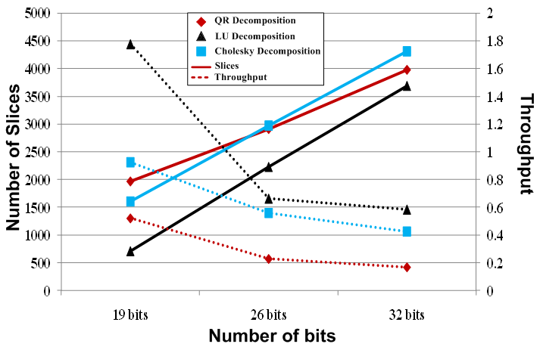
Results
Architectural Design Alternatives

Slide 27
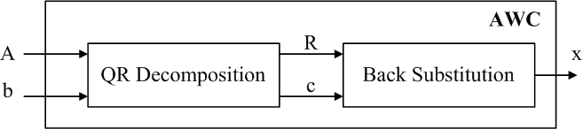
Results
Comparison with Previously Published Work: AWC
 | Edman et al. | Karkooti et al. | Dick et al. |  | GUSTO
Application | Matrix Inversion | Matrix Inversion | Beamformer |  | AWC
Method | QR | QR | QR |  | QR
Matrix Size | 4 × 4 | 4 × 4 | 3 × 3 | 5 × 5 | 4 × 4
Bit width | 12 | 20 | 18 |  | 20
Data type | fixed | floating | NR |  | fixed
Device type | Virtex 2 | Virtex 4 | Virtex 4 |  | Virtex 4
Slices | 4400 | 9117 | 3530 |  | 2558
DSP48s | NR | 22 | 13 |  | 12
BRAMs | NR | 9 | 6 |  | 1
Throughput (10⁶×s⁻¹) | 0.28 | 0.12 | 0.27 | 0.11 | 0.13
Adaptive Weight Calculation (AWC) Core
F. Edman, V. Öwall, “A Scalable Pipelined Complex Valued Matrix Inversion Architecture”, IEEE International Symposium on Circuits and Systems. (2005).
M. Karkooti, J.R. Cavallaro, C. Dick, “FPGA Implementation of Matrix Inversion Using QRD-RLS Algorithm”, Asilomar Conference on Signals, Systems and Computers (2005).
C. Dick, F. Harris, M. Pajic, D. Vuletic, “Real-Time QRD-Based Beamforming on an FPGA Platform,” Asilomar Conference on Signals, Systems and Computers (2006).

Slide 28
Outline
Motivation
GUSTO: Design Tool and Methodology
Decomposition Methods
Results
  Inflection Point Analysis
  Architectural Design Alternatives
Conclusions

Slide 29
GUSTO
General architecture design Utility and Synthesis Tool for Optimization
Algorithm
(e.g. QR decomposition)
GUSTO
  Bit width
  (e.g. 19 bits of precision)
  Error Analysis
  Resource Allocation
  (e.g. 4 multipliers and 3 adders)
  HDL files
Modes
  (e.g. Heterogeneous cores connected using hierarchical datapaths)
GUSTO is a tool to provide automatic generation and optimization of a variety of application specific processing elements (PEs) with different parameterization options;
Current Projects includes implementation of
  Short Preamble Processing unit for OFDM Receiver design.

Slide 30
Thank You
kastner@cs.ucsd.edu

